Slide 1
Git and Git hub operations
P.Srivignesh

Slide 2

Git & Git Hub

Slide 3
Index
Git vs GitHub
Workflow
Steps ( 1 - 10)

Slide 4
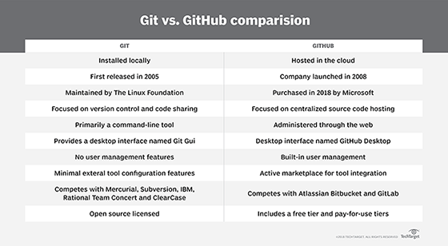
Git vs GitHub

Slide 5
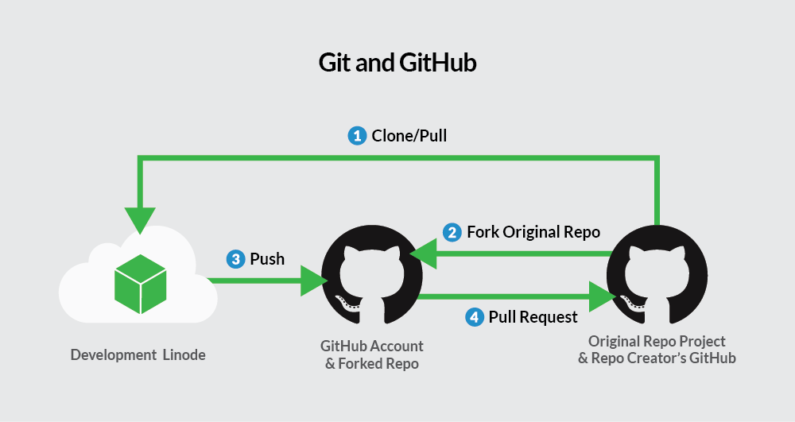
Workflow

Slide 6
Steps
Step 1: Install git and create a GitHub account
Step 2: Create a new repository on GitHub
Step 3: Open the path in command prompt
Step 4: Git init (check in the folder where new file .git will be created automatically)
Step 5: git add .
Step 6: git commit –m “word related to commit”
Step 7: git status
Step 8: git branch
Step 9: git remote add origin https://github.com/srivignesh00/Sri.git
Step 10: git push –u origin master

Slide 7
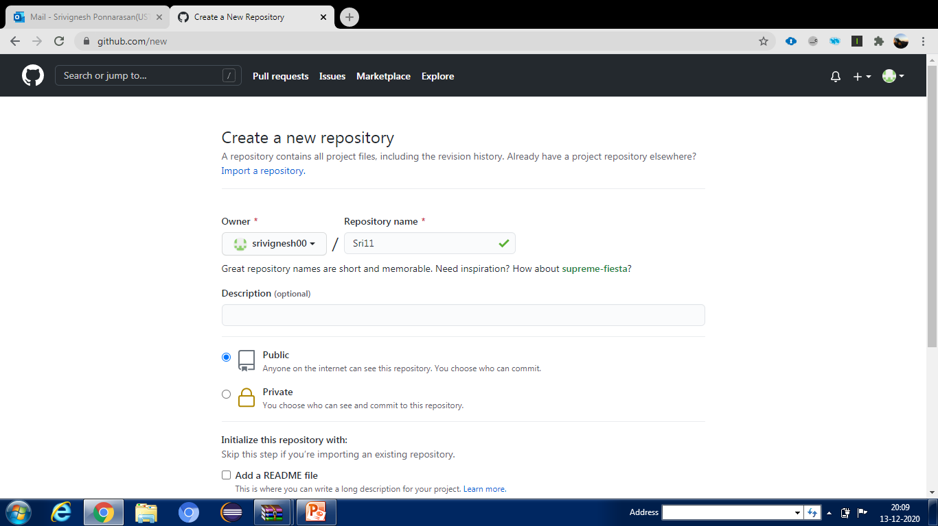
Step 2: Create a new repository on GitHub

Slide 8
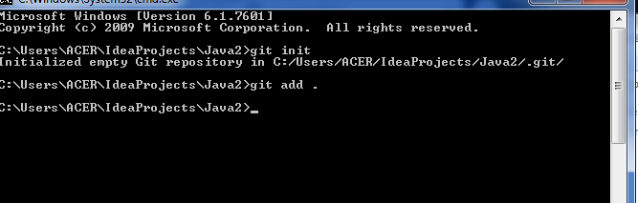
Step 4: Git init Step 5: git add .

Slide 9
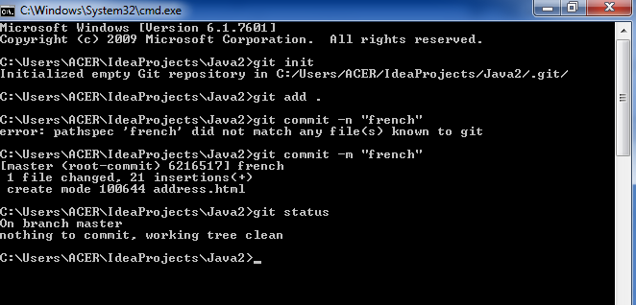
Step 6: git commit –m “word related to commit” Step 7: git status

Slide 10
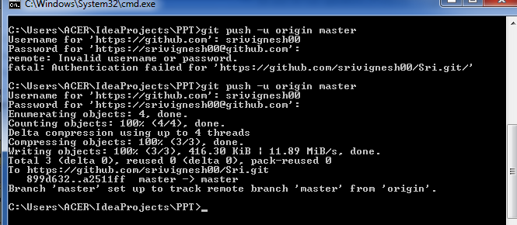
Step 8: git branch Step 9: git remote add .. Step 10: git push –u origin master

Slide 11
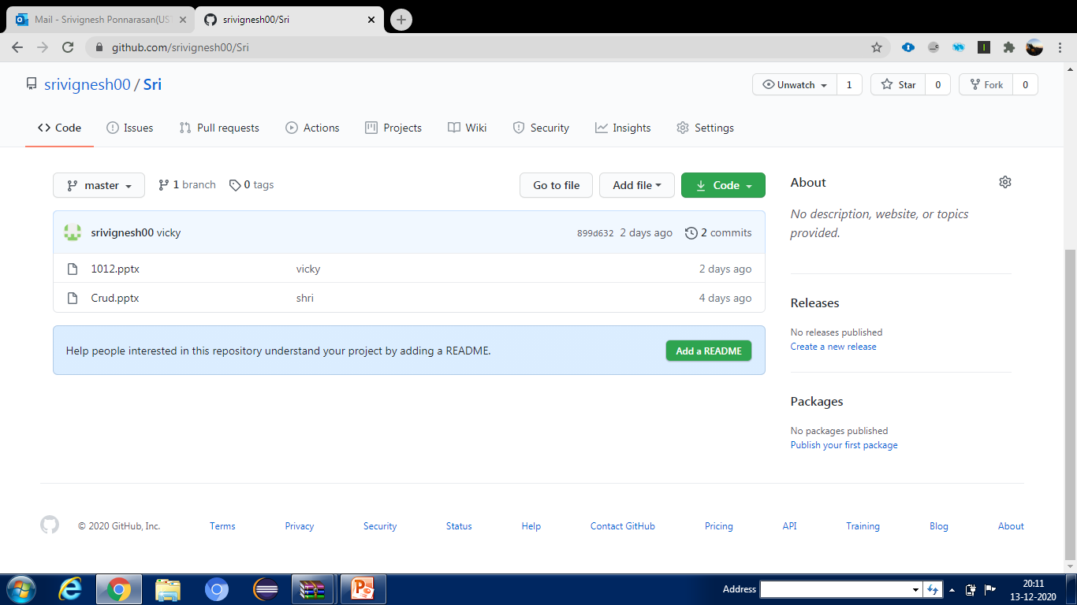
View the folder in GitHub

